Slide 1
Time the internet
CAPSTONE PROJECT
Presented By:
Sivakumar E
9513- Jayaraj Annapackiam CSI College of Engineering
B.E Mechanical Engineering

Slide 2
OUTLINE
Problem Statement
Proposed System/Solution
System Development Approach
Algorithm & Deployment
Result
Conclusion
Future Scope
References

Slide 3
Problem Statement
You are tasked with measuring the time it takes for a request to travel from your device to a specific website on the internet and back. This process is known as round-trip time (RTT) measurement and is crucial for assessing network performance and latency.
Your goal is to develop a program that performs the following tasks:
Allows the user to input the URL (Uniform Resource Locator) of the website they want to measure.
Sends a request to the specified URL and measures the time it takes for the response to return.
Displays the round-trip time (RTT) in milliseconds (ms) to the user.

Slide 4
Proposed Solution
The proposed solution for measuring the round-trip time (RTT) of a request to a specific website using Python and the requests library is effective for basic RTT measurement. Here's an analysis of the solution:
Key Components:
URL Input: Allows the user to input the URL they want to measure the RTT for measure_rtt Function:
Sends an HTTP GET request to the specified URL using the requests library.
Measures the time before sending the request (start_time) and after receiving the response (end_time).
Calculates the RTT in milliseconds by subtracting start_time from end_time and converting to milliseconds.
Handles any request exceptions (e.g., invalid URL, network errors) and prints an error message.
Example Usage: Demonstrates how to use the measure_rtt function with user input.
Strengths
Simplicity
Error Handling

Slide 5
System Approach
Certainly, here's a system approach for measuring the round-trip time (RTT) of requests to websites:
1. Requirements Gathering:
Identify the need for measuring RTT.
Determine the scope of the system (e.g., single URL measurement, concurrent measurements, error handling).
2. System Design Components:
User Interface: Interface for users to input URLs and view RTT results.
RTT Measurement Module: Responsible for sending requests, measuring RTT, and handling errors.
Logging and Error Handling: Logging mechanisms to track measurements and handle errors gracefully.
Concurrency Management (Optional): If measuring RTT for multiple URLs concurrently, implement concurrency management using Asuncion or threading.
Flow:
User inputs the URL to measure RTT.
The system sends an HTTP request to the URL and measures the time before and after the request.
RTT is calculated and displayed to the user.
Errors, if any, are logged and displayed to the user

Slide 6
Algorithm & Deployment
Algorithm for Measuring RTT:
Input:
Obtain the URL from the user.
Send Request:
Use the requests library in Python to send an HTTP GET request to the specified URL.
Record the current time as the start time (start_time).
Receive Response:
Receive the response from the URL.
Record the current time as the end time (end_time).
Calculate RTT:
Calculate the RTT in milliseconds by subtracting start_time from end_time and converting the result to milliseconds.
Output:
Display the calculated RTT to the user.

Slide 7
Deployment
Environment Setup:
Install Python and the required libraries (requests, time) on the deployment server.
Code Deployment:
Deploy the Python script that implements the RTT measurement algorithm to the server.
Security Considerations:
If measuring RTT for external URLs, ensure that the server has internet access and proper firewall configurations.
Use HTTPS for sending requests to ensure secure communication.
Logging and Error Handling:
Implement logging to record RTT measurements and any errors encountered during the process.
Configure error handling to handle exceptions such as invalid URLs or network errors gracefully and provide informative messages to users.
Monitoring and Maintenance:
Monitor the system logs regularly for any anomalies or errors.
Perform routine maintenance tasks such as updating dependencies and addressing security vulnerabilities.

Slide 8
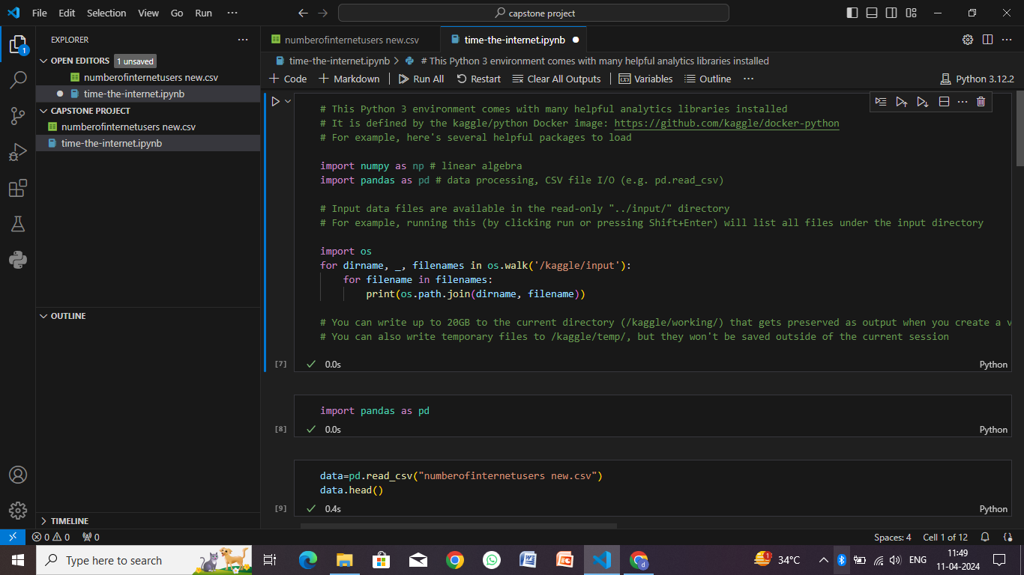
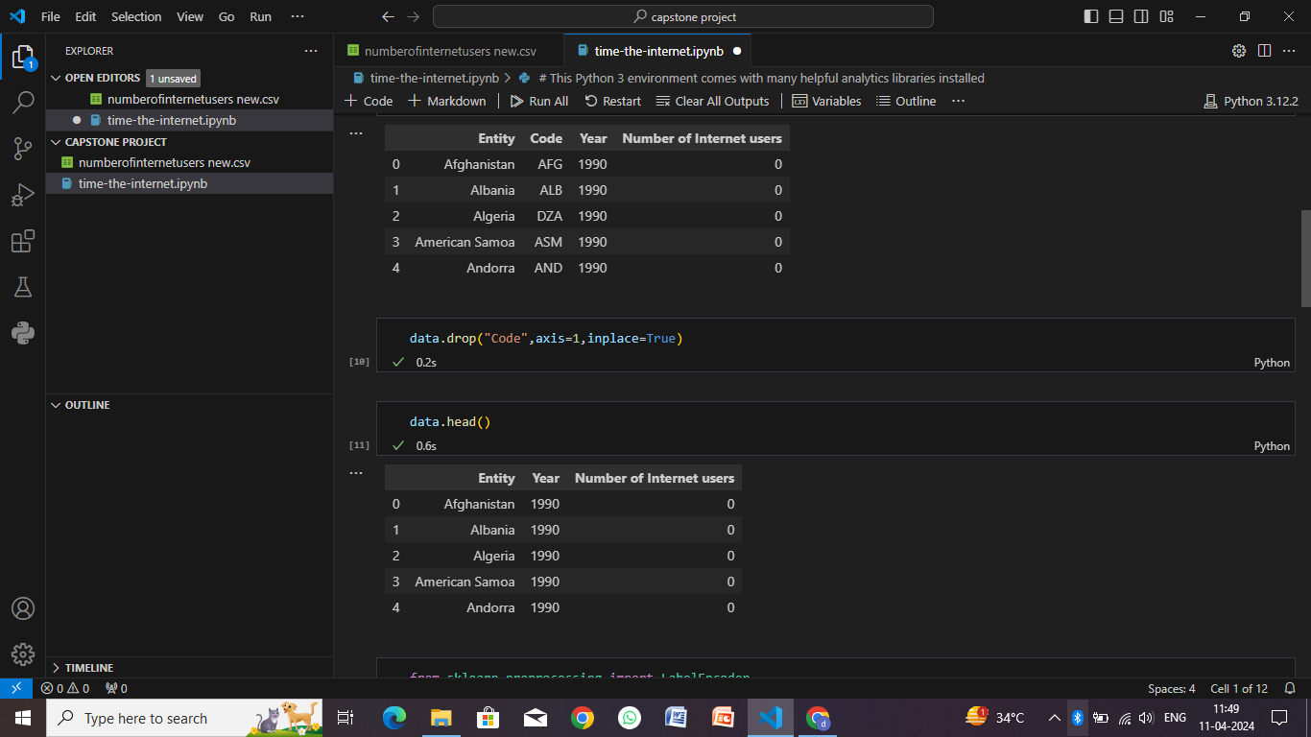
Result

Slide 9
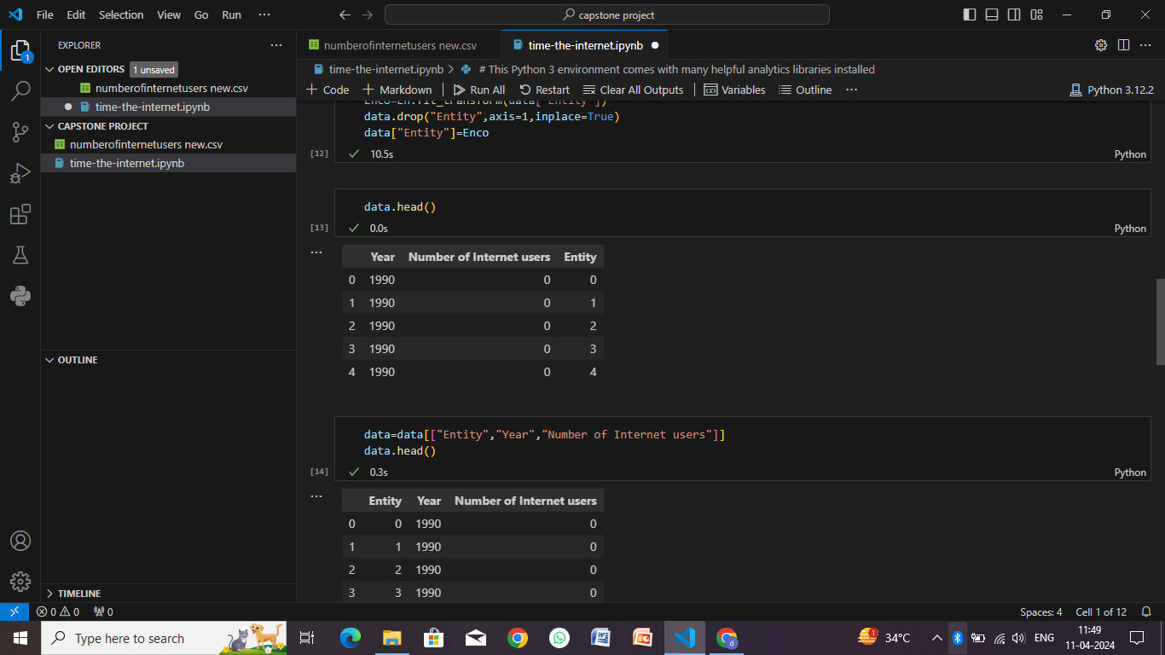
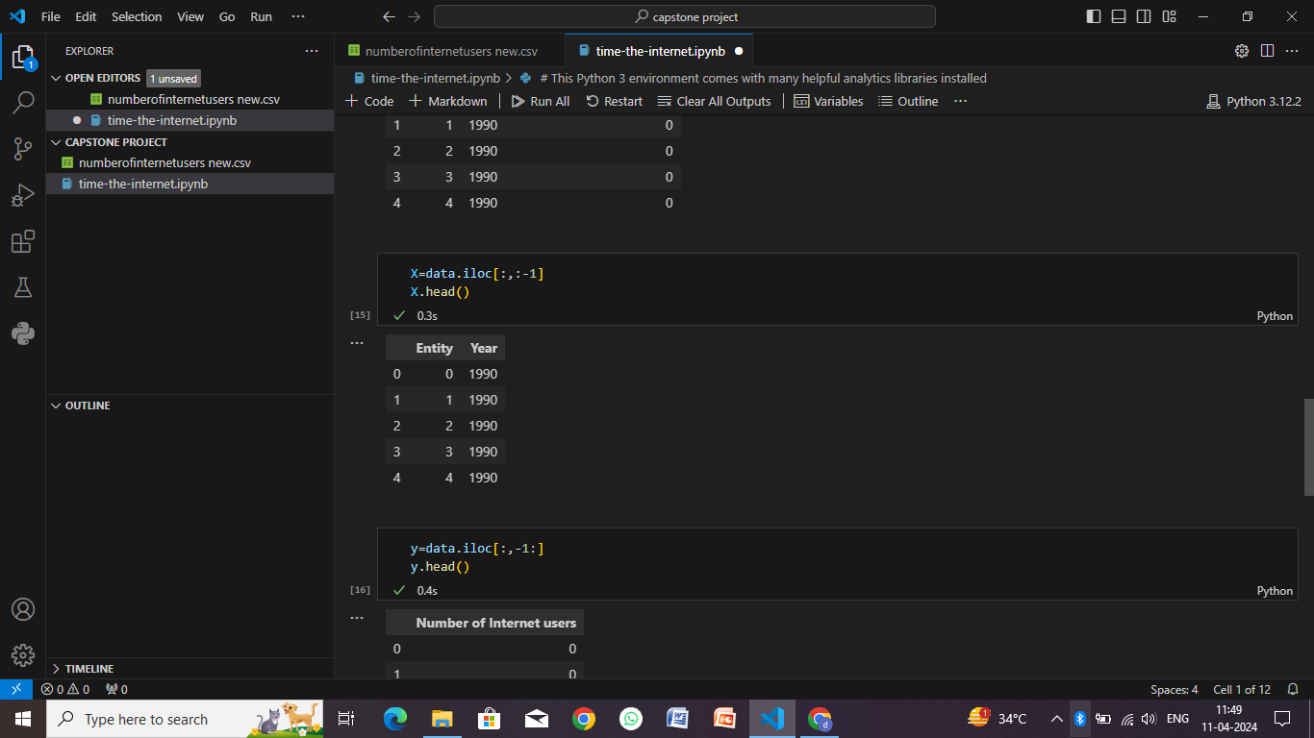

Slide 10
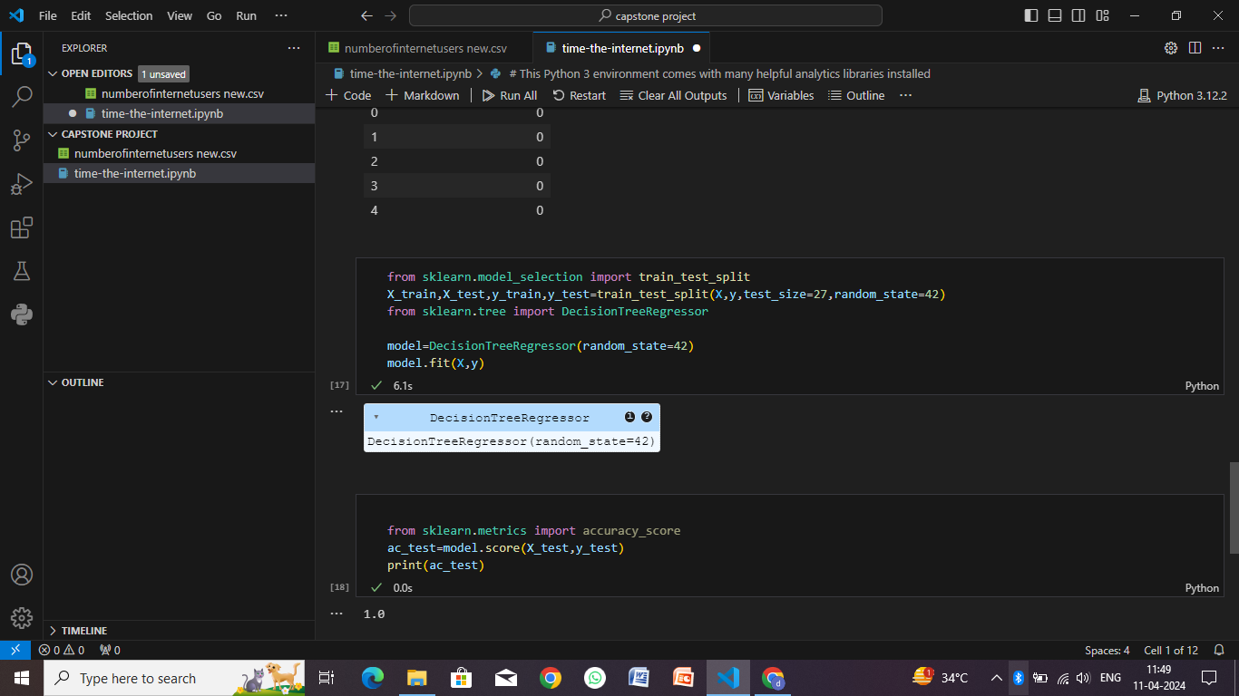
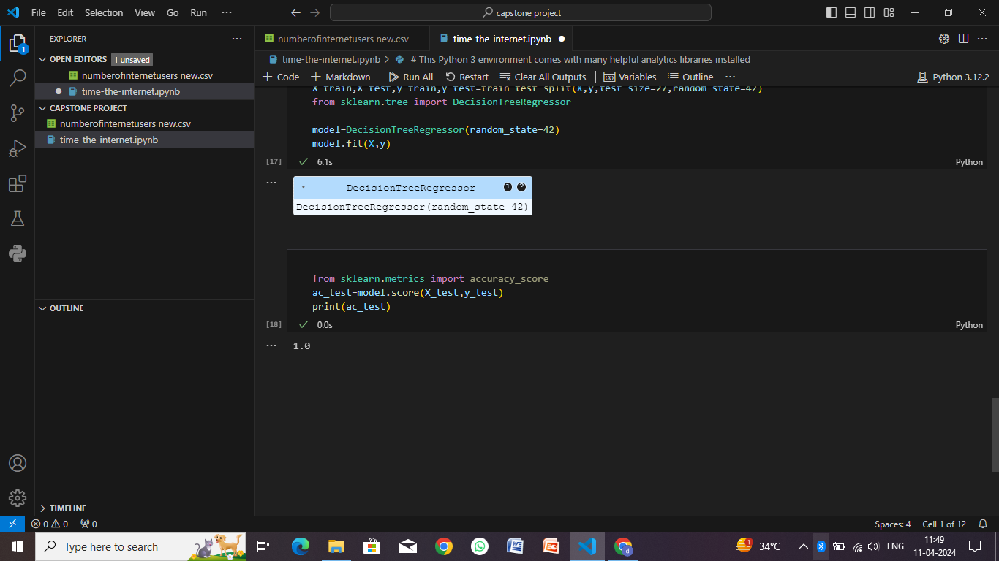

Slide 11
Conclusion
In conclusion, the process of measuring the round-trip time (RTT) of requests to websites involves developing an algorithm that sends HTTP requests, measures the time taken for the responses to return, calculates the RTT, and provides the result to users. Here's a summary of the key points:
Algorithm Overview:
Input: Obtain the URL from the user.
Send Request: Use the requests library in Python to send an HTTP GET request to the specified URL.
Receive Response: Receive the response from the URL and record the time.
Calculate RTT: Calculate the RTT by subtracting the start time from the end time.
Output: Display the calculated RTT to the user.
Deployment Steps:
Environment Setup: Install Python and required libraries (requests, time) on the deployment server.
Code Deployment: Upload the Python script implementing the RTT measurement algorithm to the server.
Security Considerations: Ensure secure communication (e.g., using HTTPS) and proper firewall configurations.
Monitoring and Maintenance: Monitor system logs regularly, perform routine maintenance, and update dependencies.

Slide 12
Future scope
The process of measuring round-trip time (RTT) for internet requests has several avenues for future development and enhancement:
Advanced Performance Metrics
Real-Time Monitoring
Geographical Analysis:
Intelligent Routing
Integration with Network Management Systems
Historical Data Analysis
Mobile Network Performance
Cross-Platform Compatibility
Security Monitoring
API and Integration
Quality of Service (QoS) Optimization

Slide 13
References
Python Requests Library Documentation:
Website: Requests Library Documentation
Time Module Documentation:
Website: Python Time Module Documentation
Requests Library GitHub Repository:
GitHub: Requests Library Repository
HTTP GET Request Method:
MDN Web Docs: HTTP GET Request Method
Network Performance Monitoring:
SolarWinds Network Performance Monitoring: SolarWinds NPM
Python Logging Module Documentation:
Website: Python Logging Module Documentation
Python Deployment Best Practices:
Real Python: Python Deployment Best Practices
Secure HTTPS Communication:
MDN Web Docs: HTTPS - Hypertext Transfer Protocol Secure
Machine Learning for Network Optimization:
Cisco: Machine Learning for Network Optimization

Slide 14
THANK YOU

